Slide 1
Analysis pipelines for bulk sequencing
PhD. Jose Alejandro Romero Herrera
PhD. Rita Soares Monteiro
PhD. Michaela Mrugala Rothová

Slide 2
Agenda
ATACseq & ChIPseq
RNAseq
Common pipeline
Peak calling
Genomics
Transcriptomics
Data correction and normalization
Data correction and normalization
Correlation between samples
Correlation between samples
Comparison between conditions
Differential Binding Analysis
Differential Expression Analysis
Peak annotation - GO term
Motif analysis
Gene-gene correlation Networks
GO term
Functional analysis

Slide 3
RNA-seq analysis
Experimental design
Isolate RNA
Prepare library
Data correction and normalization
Untreated
Treated
Correlation between samples
Sequence
Filter and clean reads
FastQ files
Workflow
Differential Expression Analysis
Paired end reads
Single reads
Gene-gene correlation Networks
GO term
Paired end reads
Single reads
Align to reference
Create gene count matrix
 | Untreated 1 | Untreated 2 | Treated 1 | Treated 2
Gene A | 123 | 150 | 143 | 130
Gene B | 18 | 10 | 233 | 209
100 b
150 b
200 b
250 b
Bam files

Slide 4
Count matrix
Gene Name | Rep1 Counts | Rep2 Counts | Rep3 Counts
A (2 Kb) | 10 | 12 | 30
B (4 Kb) | 20 | 25 | 60
C (1 Kb) | 5 | 8 | 15
D (10 Kb) | 0 | 0 | 1
Total counts | 35 | 45 | 106
Is the expression of gene A higher in Rep3 than Rep1?
Is the expression of gene A higher than gene B in Rep1?
Do you think it is ok to compare genes and reps using this table?

Slide 5
Data correction and normalization
Gene Name | Rep1 Counts | Rep2 Counts | Rep3 Counts
A (2 Kb) | 10 | 12 | 30
B (4 Kb) | 20 | 25 | 60
C (1 Kb) | 5 | 8 | 15
D (10 Kb) | 0 | 0 | 1
Total counts | 35 | 45 | 106
Gene length bias (Kb)
Longer genes will have more reads mapping to them
Library size bias (total counts)
Deeper runs will have more reads mapping to each gene

Slide 6
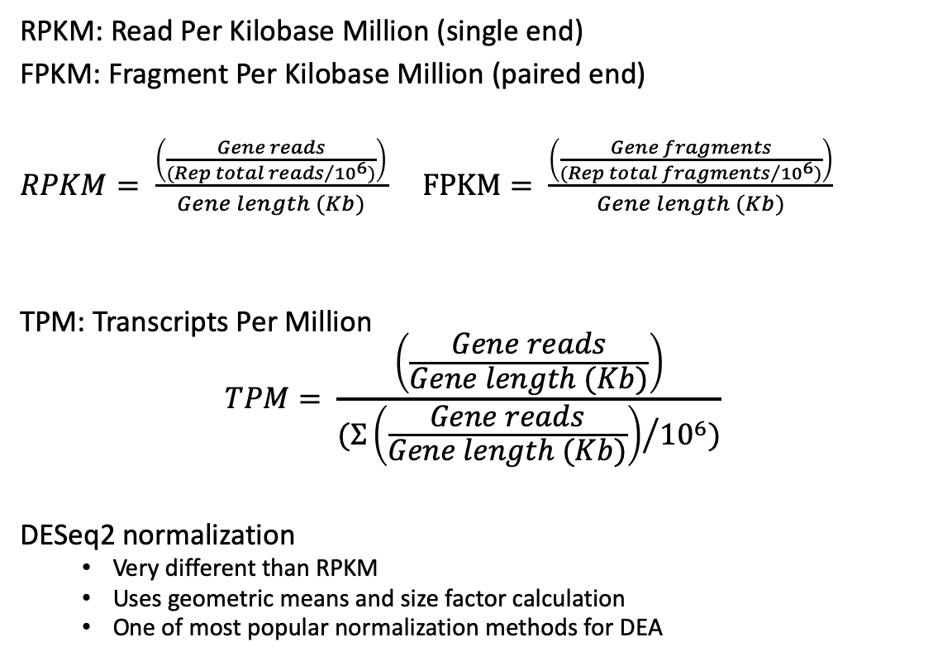
Data normalization
Gene Name | Rep1 counts | Rep2 counts | Rep3 counts
A (2 Kb) | 10 | 12 | 30
B (4 Kb) | 20 | 25 | 60
C (1 Kb) | 5 | 8 | 15
D (10 Kb) | 0 | 0 | 1
Total counts | 35 | 45 | 106
Original
RPKM: Read Per Kilobase Million (single end)
FPKM: Fragment Per Kilobase Million (paired end)
$RPKM= \frac{\left(\frac{Gene reads}{{(Rep total reads}/{{10}^{6})}}\right)}{Gene length (Kb)}$ $FPKM= \frac{\left(\frac{Gene fragments}{{(Rep total fragments}/{{10}^{6})}}\right)}{Gene length (Kb)}$
TPM: Transcripts Per Million
$$TPM= \frac{\left(\frac{Gene reads}{Gene length (Kb)}\right)}{{(Σ\left(\frac{Gene reads}{Gene length (Kb)}\right)}/{{10}^{6})}}$$
DESeq2 normalization
Very different than RPKM
Uses geometric means and size factor calculation
One of most popular normalization methods for DEA
Gene Name | Rep1 RPKM | Rep2 RPKM | Rep3 RPKM
A (2 Kb) | 1.43 | 1.33 | 1.42
B (4 Kb) | 1.43 | 1.39 | 1.42
C (1 Kb) | 1.43 | 1.78 | 1.42
D (10 Kb) | 0 | 0 | 0.009
Total | 4.29 | 4.5 | 4.269
RPKM
*Divided by 10, not 10⁶
Gene Name | Rep1 TPM | Rep2 TPM | Rep3 TPM
A (2 Kb) | 3.33 | 2.96 | 3.326
B (4 Kb) | 3.33 | 3.09 | 3.326
C (1 Kb) | 3.33 | 3.95 | 3.326
D (10 Kb) | 0 | 0 | 0.02
Total | ~10 | ~10 | ~10
TPM
Notes:
DESeq: https://doi.org/10.1186/gb-2010-11-10-r106

Slide 7
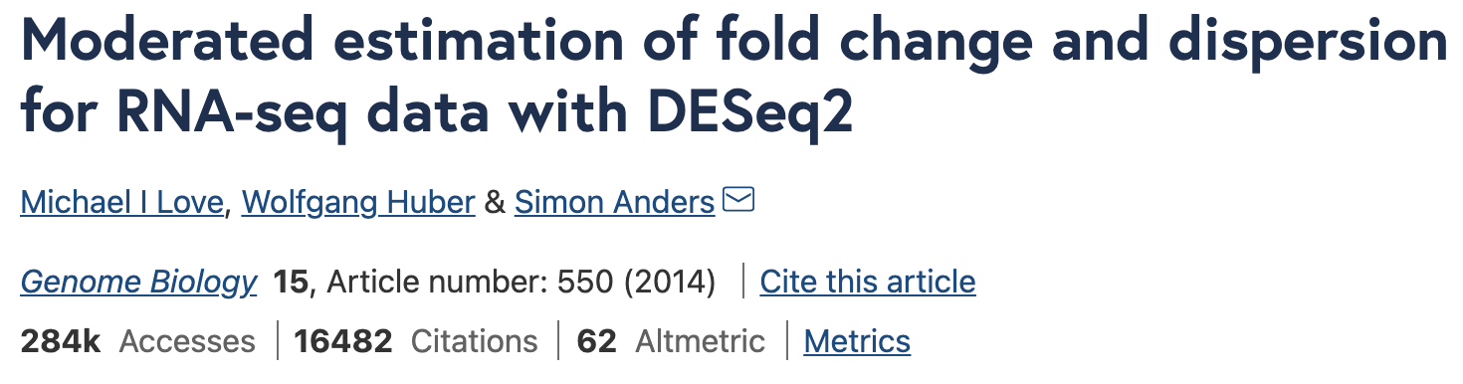
DESEQ2 package
One of the most (if not most) used packages for RNAseq analysis
Normalize your data
Compare your samples
Find Differentially Expressed Genes between conditions
Notes:
DESEQ2 original paper: https://genomebiology.biomedcentral.com/articles/10.1186/s13059-014-0550-8
Usage tutorial: https://www.bioconductor.org/packages/devel/bioc/vignettes/DESeq2/inst/doc/DESeq2.html

Slide 8
Sample comparison and correlation
After DESEQ2 normalization, some transformations on the data are useful to compare samples
Log₂ normalization is used to avoid high variance in when gene count is very low
This is not used for Differential Expression Analysis (DEA)
Principal Component Analysis (PCA)
Sample
distances

Slide 9
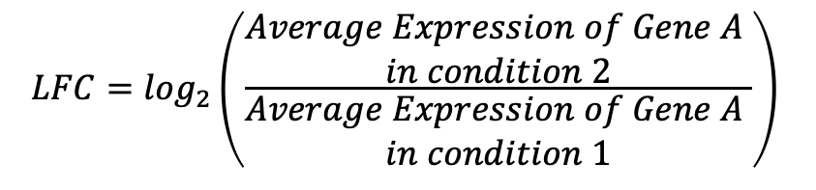
Differential Expression Analysis (DEA)
Ultimate goal of RNAseq is to compare expression between conditions
Calculation of Log₂ Fold Changes (LFC) and their statistical significance
Fold change: ratio or subtraction of mean expression levels between conditions
P-value: probability of observing the fold change if it was due by chance
Filter significant DE between conditions
Absolute LFC > 1 ( >1 or < -1), adjusted p-value < 0.05
Visualization with volcano plots, heatmaps and MA plots
$$LFC=\log_{2}\left(\frac{\begin{aligned}Average Expression of Gene A \\ in condition 2\end{aligned}}{\begin{aligned}Average Expression of Gene A \\ in condition 1\end{aligned}}\right)$$

Slide 10
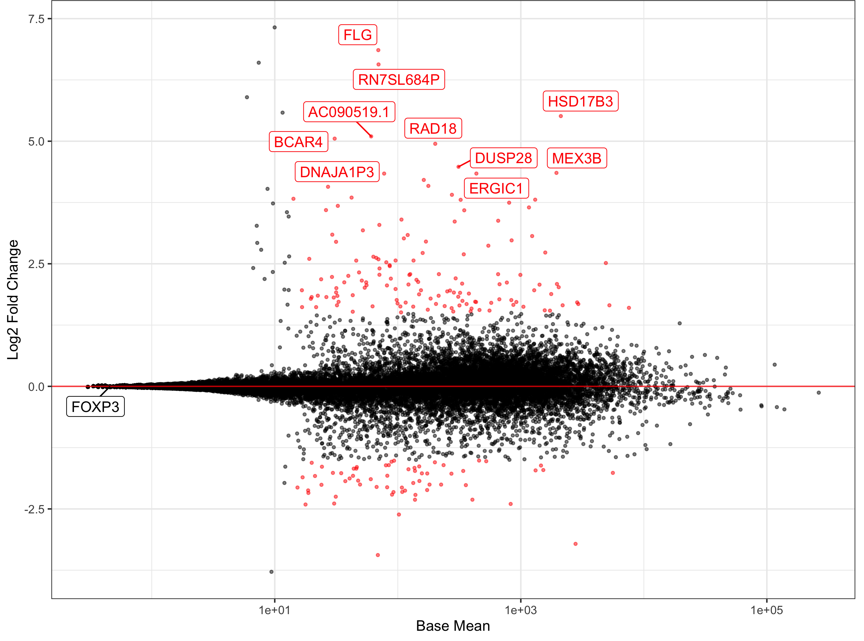
DEA visualization
MA plot
Genes more expressed
in treated cells (LFC > 1)
Volcano plot
Log₂ Fold Change
-Log₁₀(Adjustedp-value)
Base mean
Genes more expressed
in untreated cells (LFC < 1)
Log₂ Fold Change

Slide 11
DEA visualization
Heatmap of expression
Showing UP regulated genes (LFC > 1)
in stimulated vs untreated cells

Slide 12
Gene-gene correlation analysis
Identify clusters of genes correlating with each other in a condition
Replicates and conditions are compared
Clusters can be used for GO term and pathway
analysis
Tools: DGCA
https://doi.org/10.1186/s12918-016-0349-1

Slide 13
Gene-gene network analysis
Gene correlations can be used to construct networks for differential changes between conditions
Network can be as well divided in subsets
Network tool: Cytoscape
Annotation for network: String
https://doi.org/10.1186/s12918-016-0349-1
Notes:
Cytoscape: https://cytoscape.org/

Slide 14
GO term and pathway analysis
GO term
Formal representation of a body of knowledge in the biological domain
Genes are annotated to different sets of knowledge
Biological processes: DNA repair, signal transduction, etc.
Molecular function: catalysis, transportation, etc.
Cellular component: ribosome, nucleus, etc.
Pathways
Set of genes connected to each other in a specific biological function
KEGG pathway database
Metabolism
Genetic information processing
Environmental Information Processing
Cellular processes
Organismal Systems
Human Diseases
Notes:
Gene ontology webpage: http://geneontology.org/
KEGG pathway database webpage: https://www.genome.jp/kegg/pathway.html

Slide 15
Enrichment Analysis
Definition
Identify classes of genes that are over-represented in a large set of genes, and may have an association with a body of knowledge
Returns scores or p-values
Different ways:
SEA
GSEA
MEA
https://doi.org/10.1016/j.coisb.2019.04.002
Notes:
Read more! https://www.sciencedirect.com/science/article/pii/B9780128096338204044

Slide 16
Tools
PANTHER, DAVID, GOrilla, Ontologizer
Notes:
Gene ontology tools
GOrilla: http://cbl-gorilla.cs.technion.ac.il/
PANTHER: http://www.pantherdb.org/
Ontologizer: http://ontologizer.de/
KEGG pathway analysis:
DAVID: https://david.ncifcrf.gov/

Slide 17

Workflow
Experimental design
Create gene count matrix
Normalization
 | Unt 1 | Unt 1 | Treat 2 | Treat 2
Gene A | 123 | 150 | 143 | 130
Gene B | 18 | 10 | 233 | 209
DESeq
 | Unt 1 | Unt 1 | Treat 2 | Treat 2
Gene A | 13.8 | 14.2 | 12.4 | 14.6
Gene B | 1.9 | 1.25 | 24.1 | 20.9
Untreated
Treated
Sample comparison
GO term and pathway analysis
DE analysis
DESeq
GOrilla,
DAVID,
PANTHER
Distance heatmap and PCA
MA plots, Volcano plots or Heatmaps
Network analysis
Gene-gene correlation analysis
Cytoscape
DGCA

Slide 18
ATACseq & ChIPseq
DOI: 10.1016/j.preteyeres.2016.06.001
Peak calling
Data correction and normalization
Correlation between samples
Workflow
Differential Binding Analysis
Peak annotation - GO term
Motif analysis

Slide 19
Peak calling. MACS2
Modelled peak
Sense
“tag” or “read”
5’
3’
3’
5’
Anti sense “tag” or “read”
Comparison with “background”, ”noise” or “control”
Protein of interest
Control (no IP) or INPUT peak
Align tags to reference genome
Statistics and output
Modified BED file
Chr | Start | End | Peak-ID | Score | P-value
1 | 12345 | 12400 | Abcd | 20 | 0.0002
Reference genome
Read count on each peak
Chr | Start | End | Peak-ID | Score | P-value | Value
1 | 12345 | 12400 | Abcd | 20 | 0.0002 | 20
Bimodal model

Slide 20
Peak calling. Consensus peakset
Replicates or clones may be heterogenous
Get “consensus” peakset of “true” peaks per condition
Those that appear in almost all samples
Binding site overlaps

Slide 21
Sample comparison and correlation
Comparison based on
between peak values or scores
Distance heatmap
PCA

Slide 22
Differentially bound sites
Calculate statistics for different conditions
(mean, median, sd, etc.)
Test differences between peak values
Generate Fold changes and p-values
Visualize results
Analysis using Diffbind tool
Notes:
Diffbind: http://bioconductor.org/packages/release/bioc/vignettes/DiffBind/inst/doc/DiffBind.pdf

Slide 23
Visualization of differentially bound sites
Heatmaps
Volcano plot

Slide 24
Peak annotation
Peaks can be annotated to the closest gene TSS
Insight to functionality of the region
Important for GO term and pathway analysis
Tools
Annotation: GREAT, ChIPseeker, etc.
GO term: PANTHER, GOrilla, Ontologizer
Notes:
Annotation
GREAT: http://great.stanford.edu/public/html/
ChIPseeker: https://guangchuangyu.github.io/software/ChIPseeker/
Gene ontology tools
GOrilla: http://cbl-gorilla.cs.technion.ac.il/
PANTHER: http://www.pantherdb.org/
Ontologizer: http://ontologizer.de/
KEGG pathway analysis:
DAVID: https://david.ncifcrf.gov/

Slide 25
Motif analysis
Definition
Sequence pattern that is widespread and may have a biological significance
Ribosome binding sites, restriction enzymes, RNA polymerase
Tools: HOMER, gimme
Notes:
HOMER: http://homer.ucsd.edu/homer/motif/
Gimme: https://gimmemotifs.readthedocs.io/en/master/

Slide 26
Workflow
Peak calling
Consensus peak
Peak read count
Experimental design
Align to reference
MACS2
Diffbind
Diffbind
150 b
200 b
Bam files (without duplicates!)
Untreated
Treated
Differential binding analysis
Sample comparison
GO term and pathway analysis
Diffbind
GOrilla,
DAVID,
PANTHER
Volcano plots or Heatmaps
Distance heatmap and PCA
Peak annotation
Motif analysis
ChIPSeeker, GREAT
Homer, GimmeMotifs

